Slide 1

Skycast Weather Forecast App
A modern, location-aware web application delivering real-time weather data, weekly forecasts, and interactive maps — all in one seamless interface.
MINI PROJECT · WEB DEVELOPMENT

Slide 2


The Problem We're Solving
Fragmented Information
Users juggle multiple apps and websites to get current conditions, forecasts, and location-based data — no single unified experience.
No Real-Time Location Awareness
Most basic weather tools require manual city input, missing the
opportunity to auto-detect and serve hyperlocal data instantly.
Lack of Visual Context
Raw numbers without charts or maps make it hard to understand trends, temperature patterns, and geographic context at a glance.

Slide 3
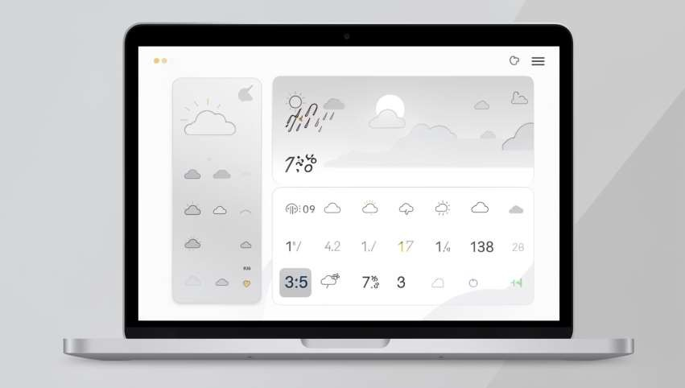

Project Objective
Skycast is designed to be a single, intuitive web application that consolidates all essential weather information into one cohesive experience.
Instant Access
Auto-detect user location and display current weather without manual input.
Visual Forecasting
Present 7-day forecasts with interactive temperature charts for easy trend analysis.
Map Integration
Pinpoint the user's location on an interactive map alongside weather data.

Slide 4
Technologies Used
Skycast is built on a modern, lightweight front-end stack — no frameworks, no back-end required.
HTML5
Semantic structure and responsive layout foundation.
CSS3
Custom styling, animations, and a clean blue weather theme.
JavaScript
Core logic for API calls, geolocation, and dynamic UI updates.
OpenWeather API
Real-time weather data and 7-day forecast endpoints.
Chart.js
Interactive temperature trend charts rendered on canvas.
Leaflet Maps
Lightweight interactive maps with dynamic marker placement.

Slide 5
Key Features
City Weather Search
Search any city worldwide and instantly retrieve current conditions and forecast data.
Auto Location Detection
Current Weather Details
Displays temperature, humidity, wind speed, weather condition icons, and feels-like data.
Uses the browser's Geolocation API to detect and load the user's current city on launch.
Weekly Forecast + Charts
7-day outlook with a dynamic Chart.js graph showing daily high/low temperature trends.
Interactive Map
A Leaflet map centers on the user's location with a draggable marker and zoom controls.

Slide 6

System Architecture & Workflow
User Opens
App
JS Fetches
Weather
Search New
City
UI Updates
The app follows a clean client-side architecture. All data flows from the OpenWeather API through JavaScript, which
dynamically updates the DOM, renders the Chart.js graph, and repositions the Leaflet map marker — all without a page reload.

Slide 7
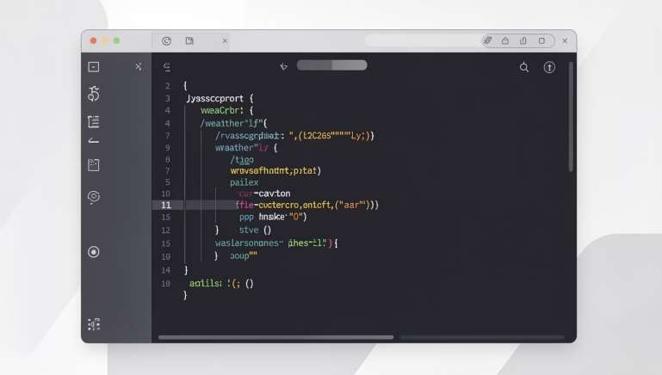
Code Implementation Overview
Core JavaScript Logic
Geolocation
navigator.geolocation.getCurrentPosit
ion()
retrieves coordinates, then reverse-
geocoded via API.
API Fetch
fetch()
calls OpenWeather's
/weather
and
/forecast
endpoints with the API key.
Chart Rendering
Chart.js initialized with forecast data arrays for daily temp max and temp min lines.
Map Marker
Leaflet's
L.map()
and
L.marker()
place
and update the pin on coordinate change.

Slide 8



Results & Screenshots
The completed application delivers a polished, fully functional weather experience across all major browsers.
Current Weather Panel
Live temperature, condition icon, humidity, and wind speed displayed prominently on load.
Temperature Chart
Chart.js renders a smooth dual-line graph of daily highs and lows across the 7-day forecast.
Interactive Map View
Leaflet map centers on the detected or searched location with a draggable, updating marker.

Slide 9
Challenges & Future Enhancements
⚡ Challenges Faced
🚀 What's Next
API Rate Limiting
Geolocation Permissions
Weather Alerts
Dark / Light Mode
Managing OpenWeather's free-tier call limits required careful caching of responses.
Push notifications for severe weather warnings in the user's area.
Theme toggle for improved accessibility and user preference support.
Handling denied permissions gracefully with a fallback search prompt.
Backend & PWA
Chart Responsiveness
Add a Node.js backend and convert to a Progressive
Web App for offline use.
Ensuring Chart.js resizes correctly across mobile and
desktop viewports.

Slide 10

Conclusion
Skycast demonstrates how modern front-end tools can deliver a rich, real-world application without complex infrastructure. It successfully integrates live APIs, geolocation, data visualization, and interactive maps into a unified, user-friendly experience.
✅ Built
Fully functional weather app
with 6 core features
🌐 Live Data
Real-time OpenWeather API
integration
📍 Location-Aware
Auto-detection + manual city search
Thank you for your time! Questions and feedback are welcome.
🙏

